Slide 1
AI-Proofing Assessment
Presented by
Simon Emberton
02.09.26
Notes:
For the last 8 years I have been teaching on a first-year module that teaches the building blocks of coding and students make creative outputs such as audio-visual artworks or games.
Students taking shortcuts isn’t new and even before AI we had students copy pasting code they’d found online.

Slide 2
The Original Blueprint
Research
Hand-drawn sketches
Weekly Journal
Code Comments
Video Demo
Support Sessions
Notes:
To stop cheating we put a few things in place.
Students researched their idea,
Sketched it by hand before writing a line of code,
Kept a weekly journal,
Got support in the weekly sessions,
Then in the submission demonstrated understanding through code comments and a video walkthrough.

Slide 3

The Engagement Divide
Notes:
For students who engaged week to week, the process worked well.
But a second group emerged: students who vanished during term time, then surfaced at the deadline with work that probably wasn't theirs.

Slide 4
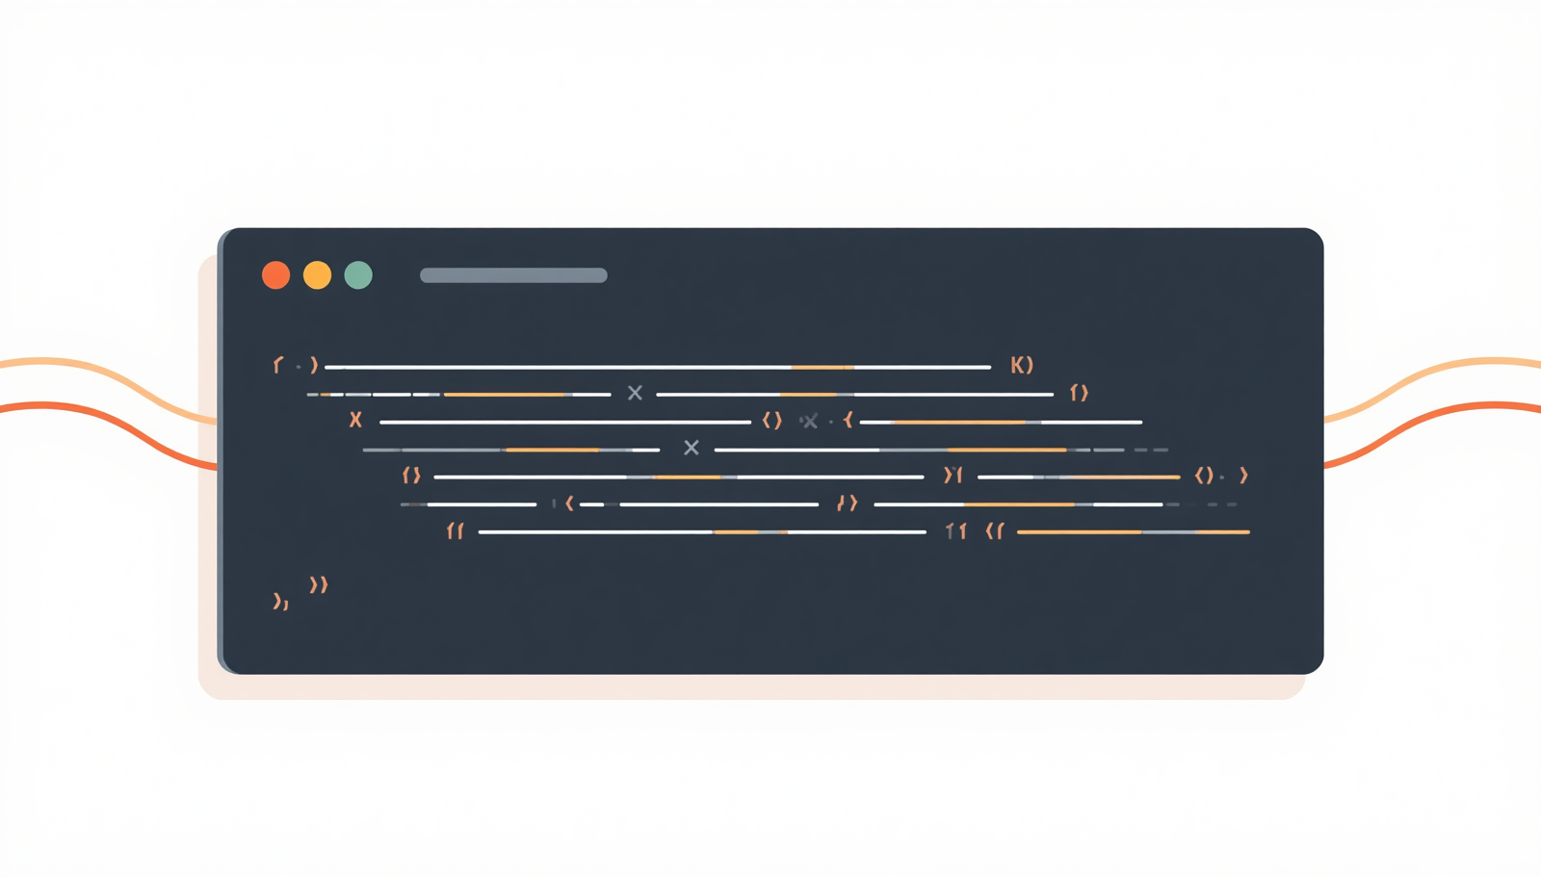
Enter Generative AI
Notes:
In the past this was easy to spot. You could easily find the work online that they’d copied.
Now with AI the whole submission can be generated in minutes and is much harder to spot.

Slide 5
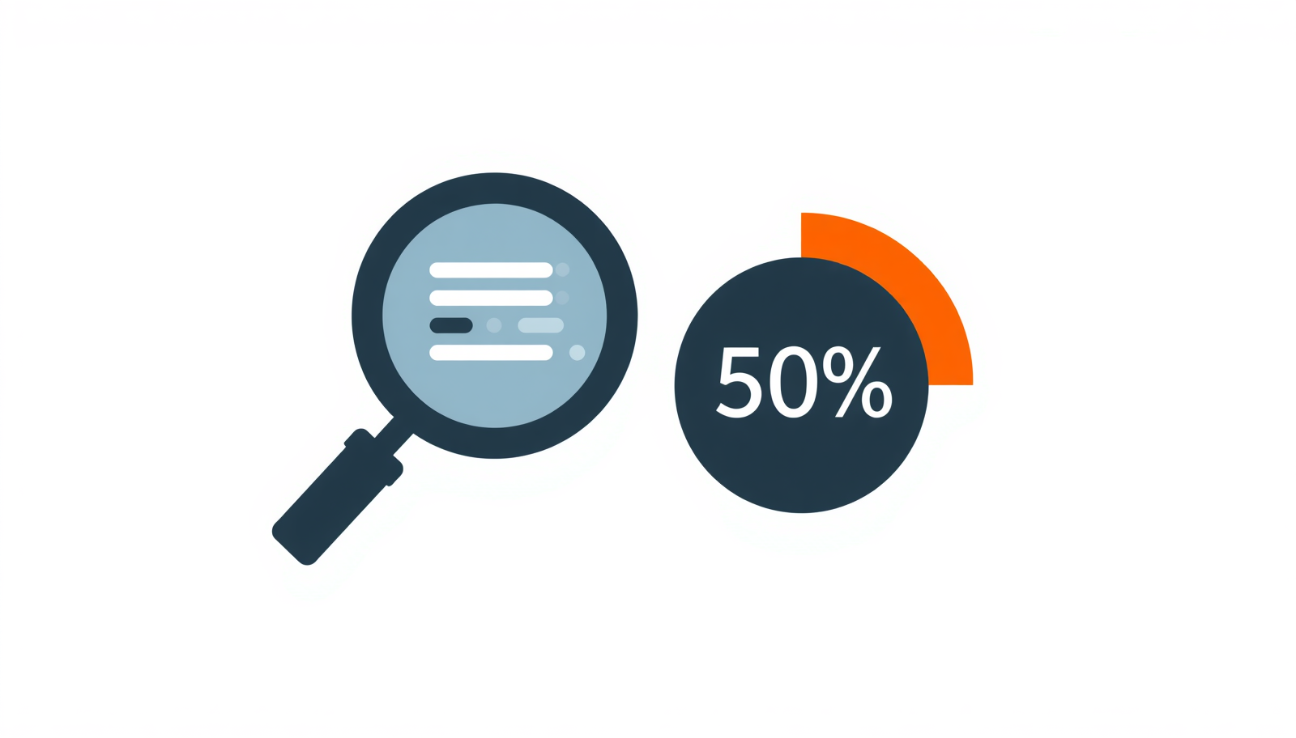
The Trap of Proof
Notes:
With AI it become increasingly difficult to prove if a student did or didn't write their own code.
The issue is that we were grading the artefact/the submission, not the student.

Slide 6

The Pivot to Understanding
Notes:
So we stopped trying to AI-proof the coursework itself.
Instead, we redesigned the assessment to measure understanding — shifting the focus entirely from what was submitted to how well the student could explain it.

Slide 7
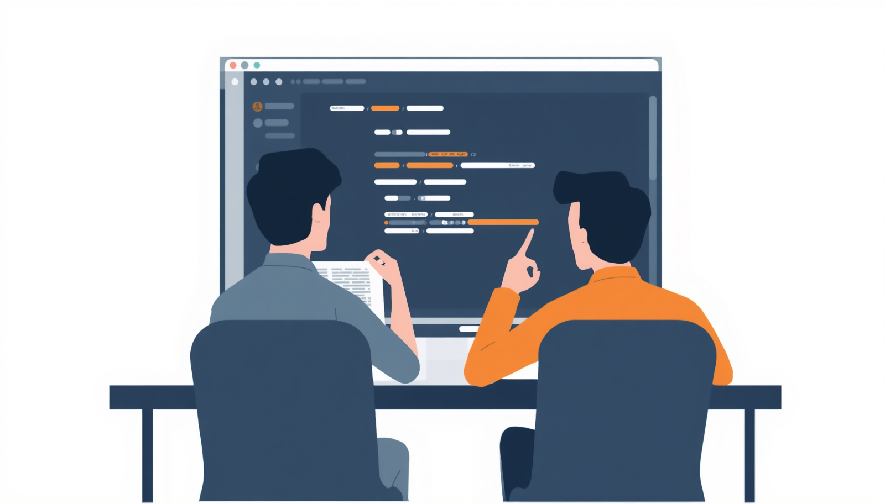
Introducing the Code Viva
Notes:
We introduced a short, mandatory viva as the core evaluation.
A five-minute conversation where students walk us through their own submission.

Slide 8
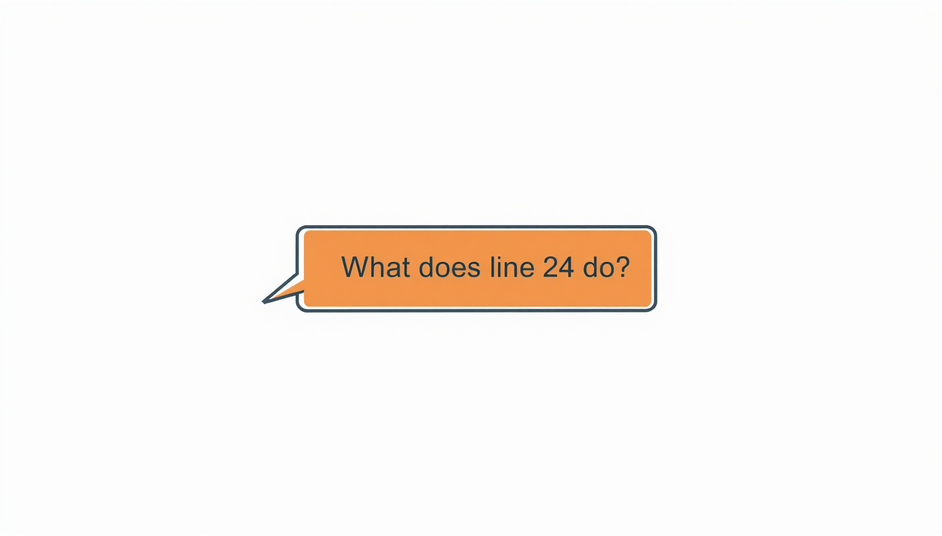
Under the Hood
Notes:
During the viva we point at their own project and ask simple things: "What does this loop do?" or "How would you change this colour gradient?"
Real understanding — or its absence — becomes obvious almost instantly.

Slide 9
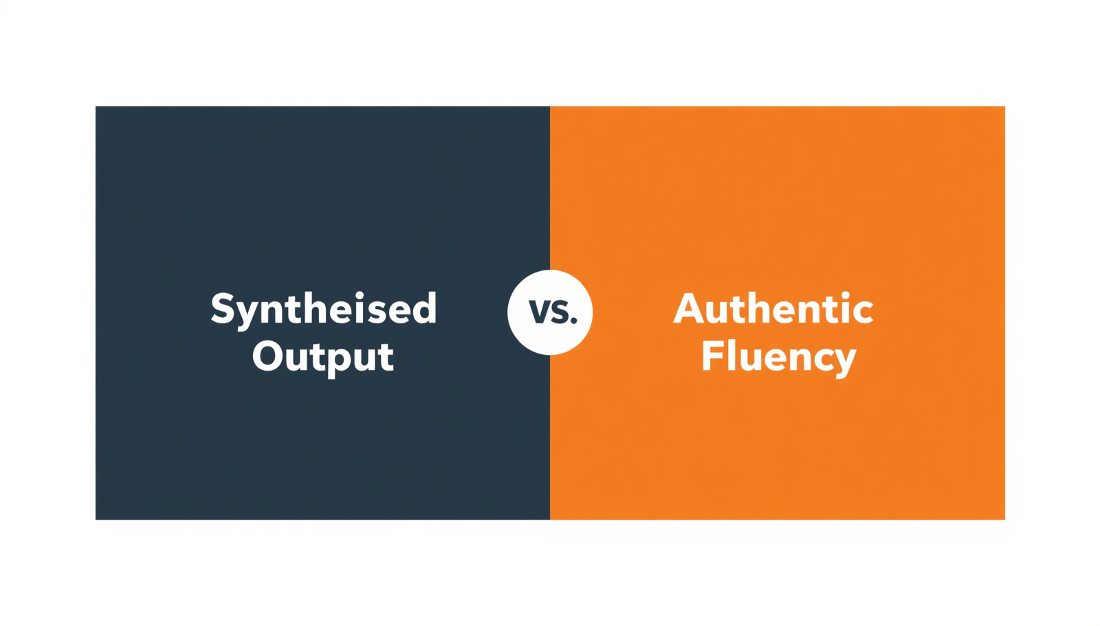
The Illusion Vanishes
Notes:
A student can't prompt their way through a live conversation.
If a student generated code without ever studying it, the gap in their knowledge shows almost straight away.

Slide 10

AI as a Tutor, Not a Proxy
Notes:
We don’t ban the use of AI. If students use it to help build their project, that's fine — but they now have to treat it as a tutor, not a shortcut, and be able to explain every line they submit.

Slide 11
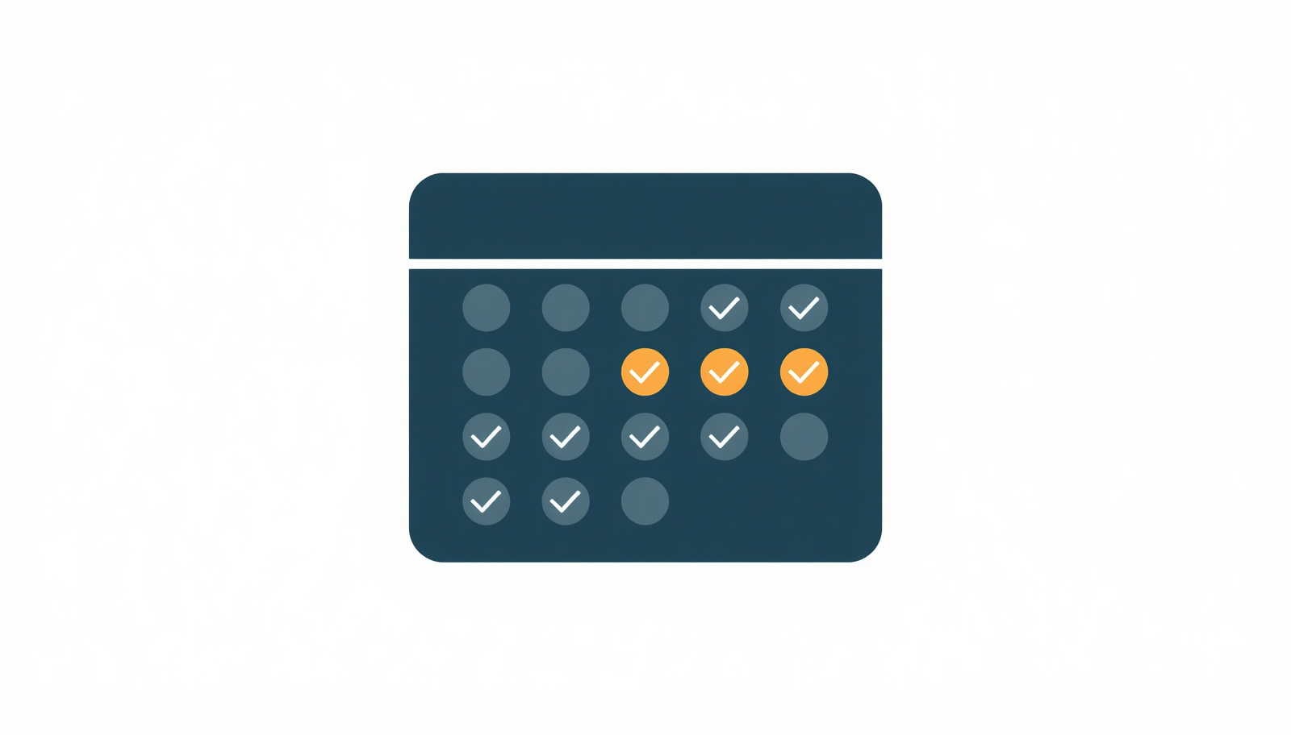
Changing Student Behaviour
Notes:
We found this positively shifted term-time behaviour.
Knowing they'll have to defend their work face to face deters last-minute panic and pulls students back into the weekly support sessions we already ran.

Slide 12

Marking as We Go
Notes:
There is also another benefit to this type of assessment.
As the marking and feedback can be carried out during the viva it makes marking much faster than before.

Slide 13

Where This Breaks Down
Notes:
Although this only works with the small cohorts of 20-30 that we have on the Digital Media programme.
If you have larger numbers the vivas would likely take up too much time.

Slide 14
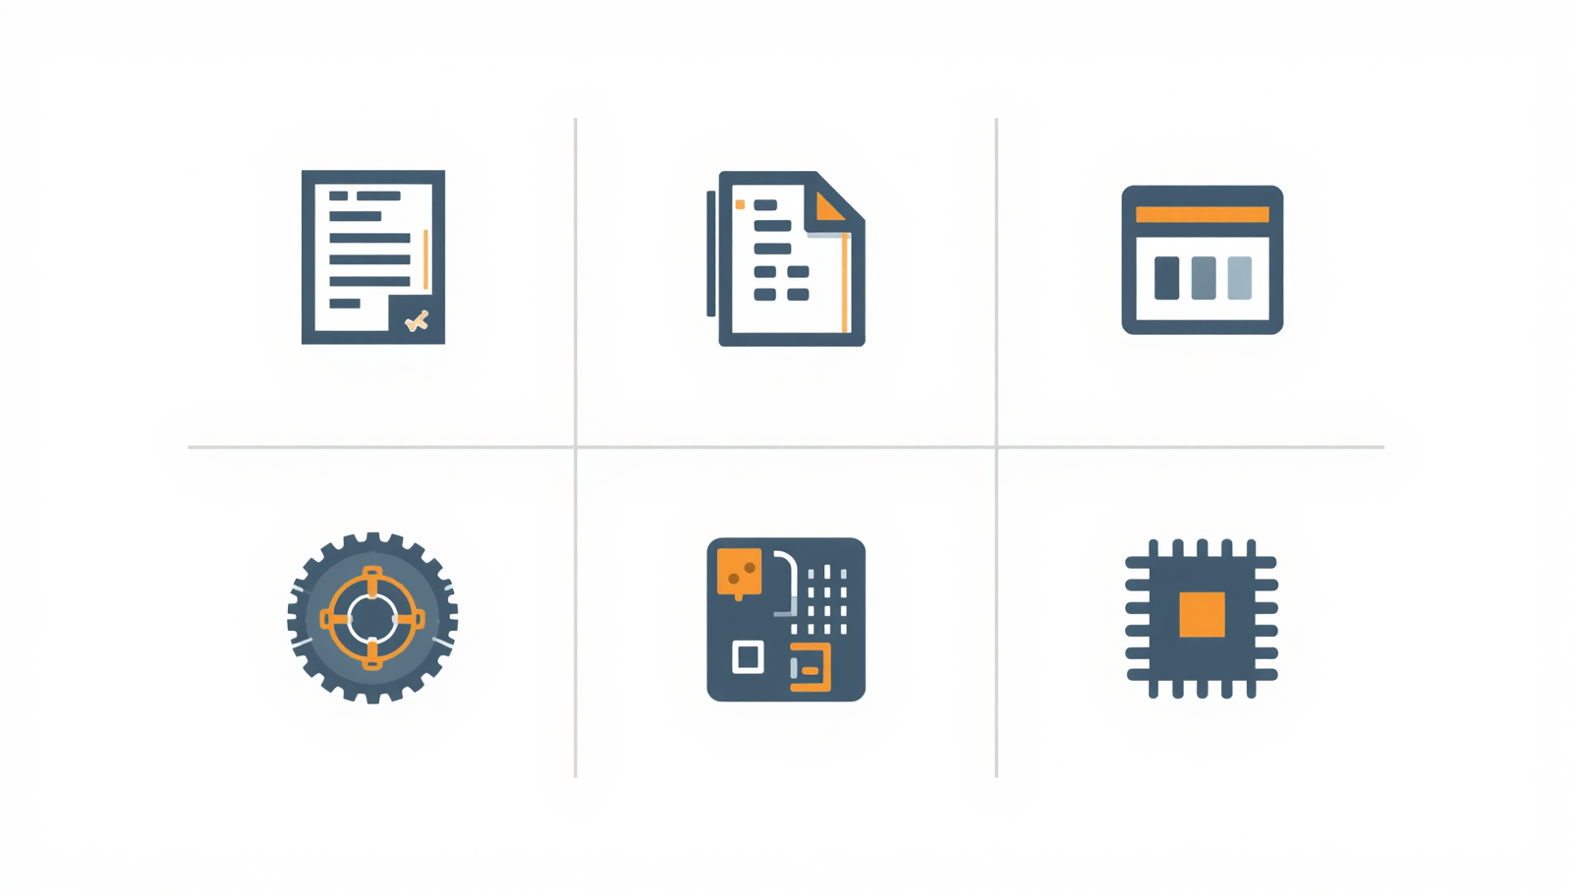
Beyond Creative Coding
Notes:
This way of assessing isn't specific to code.
Swapping a static submission for a short viva will likely work across most disciplines.

Slide 15
The Core Takeaway
Assess understanding
Notes:
In the age of AI
My advice would be to stop assessing the submitted work and rather assess the student’s understanding of the work they’ve made.

Slide 16
From Threat to Tool
Simon Emberton
Senior Lecturer in Digital Media
Simon.Emberton@uwe.ac.uk
Notes:
When we assess understanding over output, AI isn’t a threat but rather another tool in the learning process.

Slide 17
Thank you
Notes:
Thank you

