Slide 1
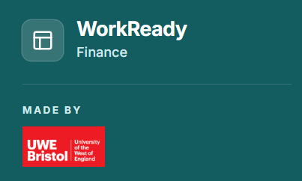
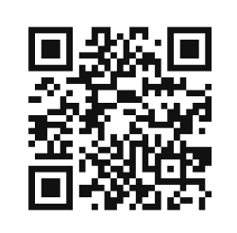
Gamifying Finance Education: Using AI to Create Engaging and Authentic Learning
Presented by
Dr Yan Zeng
Dr Rui Roberts
Dr Helen Zhang
Dr Xiaojun Luo
Date 02 Sep 2026
UWE Bristol | WorkReady Finance | Pecha Kucha

Slide 2
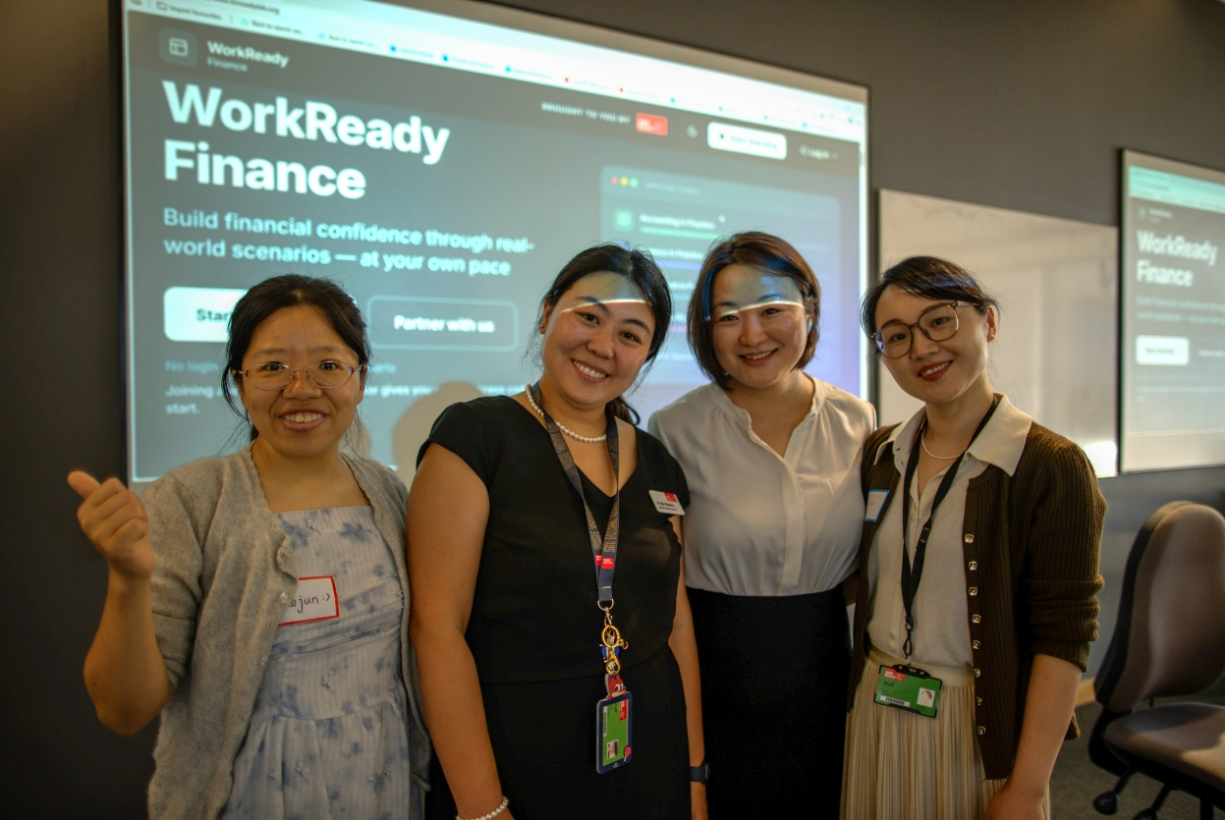
Who we are
Dr Yan Zeng - Corporate Finance
Dr Rui Roberts - Accounting
Dr Helen Zhang - Investment
Dr Xiaojun Luo - Fintech

Slide 3



FINANCE EDUCATION FOR WIDER COMMUNITIES
JOB SEEKERS
SMALL BUSINESS OWNERS
COMMUNITY LEARNERS

Slide 4
THE CHALLENGE
Finance can feel…
Σ
!
…
ABSTRACT
INTIMIDATING
PASSIVE
concepts without context
fear of getting it wrong
listen, copy, calculate
So we changed the starting point.

Slide 5
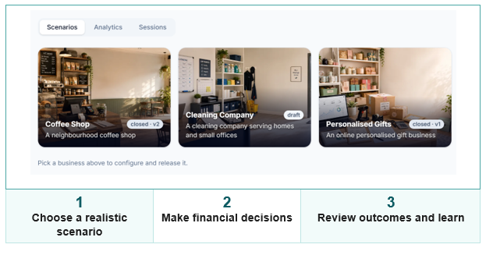
WorkReady Finance in Action
Learners choose a realistic business scenario, make financial decisions and see how their choices shape business performance.

Slide 6
THE LEARNING ENGINE
A simple game loop
2
3
1
DECIDE
Adjust
4
REFLECT
CHOOSE
DISCUSS
Low stakes. Visible consequences. Another go.
Notes:
This is the game loop: choose, decide, see the outcome, discuss it, and reflect before trying again. Gamification matters here because it creates agency and feedback in a lower-stakes space, so financial reasoning can develop through action rather than only explanation.

Slide 7

CHOOSE A BUSINESS
COFFEE SHOP
CLEANING COMPANY
PERSONALISED GIFTS
Realistic scenarios turn financial concepts into choices
Notes:
WorkReady Finance uses realistic business scenarios, including a coffee shop, a cleaning company and a personalised gifts business. That choice gives learners an immediate context: they are no longer doing finance in general; they are trying to make this particular business work.

Slide 8
WORKSHOP DESIGN
Not a demo. A conversation.
1
2
3
4
SPOTLIGHT
DEMO
Q&A
NETWORK
community & tech partners
see the scenario in action
question the choices
connect experience & ideas
The platform starts the discussion. People deepen it.
Notes:
The workshop format deliberately mixed a demonstration with Q&A, networking and community spotlights. That matters because the platform is not the whole learning experience: it starts a conversation, while participants bring lived experience, questions and different interpretations of the same financial choice.

Slide 9
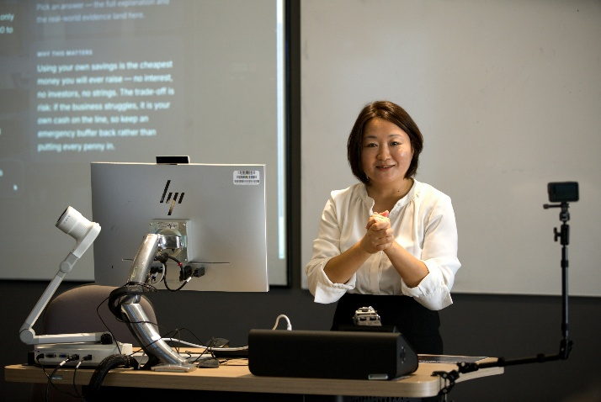
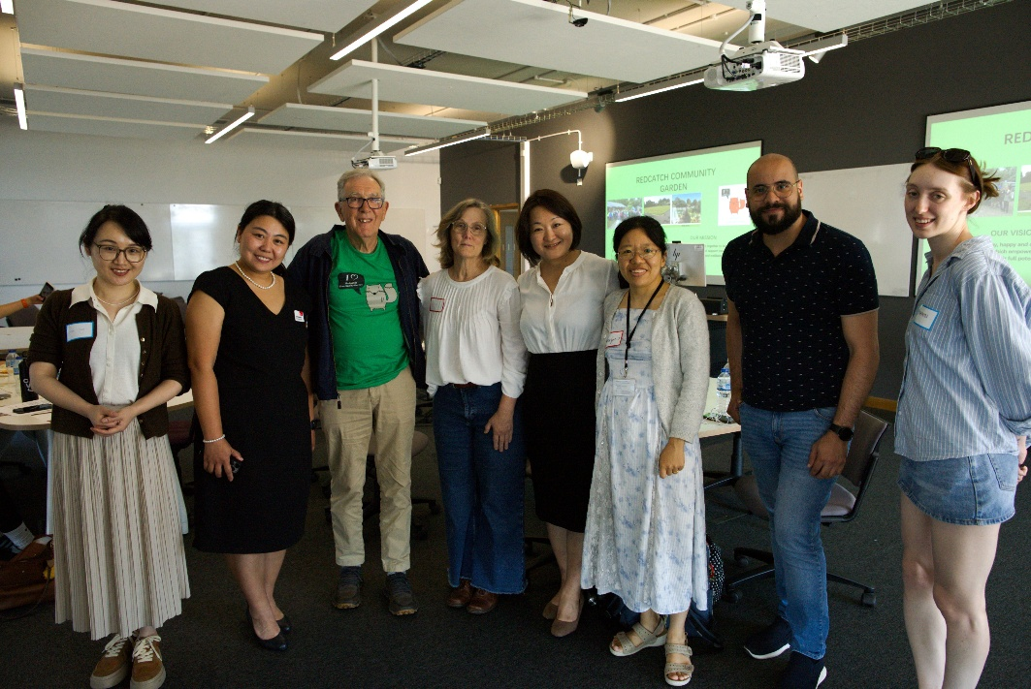

Workshop 1: Thursday 2 July 2026
12:00 - 14:00 6X101 at UWE

Slide 10
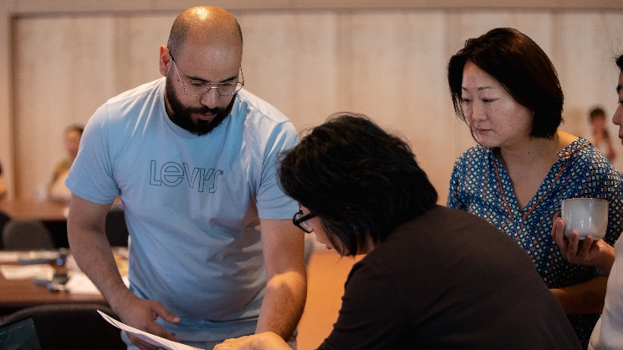
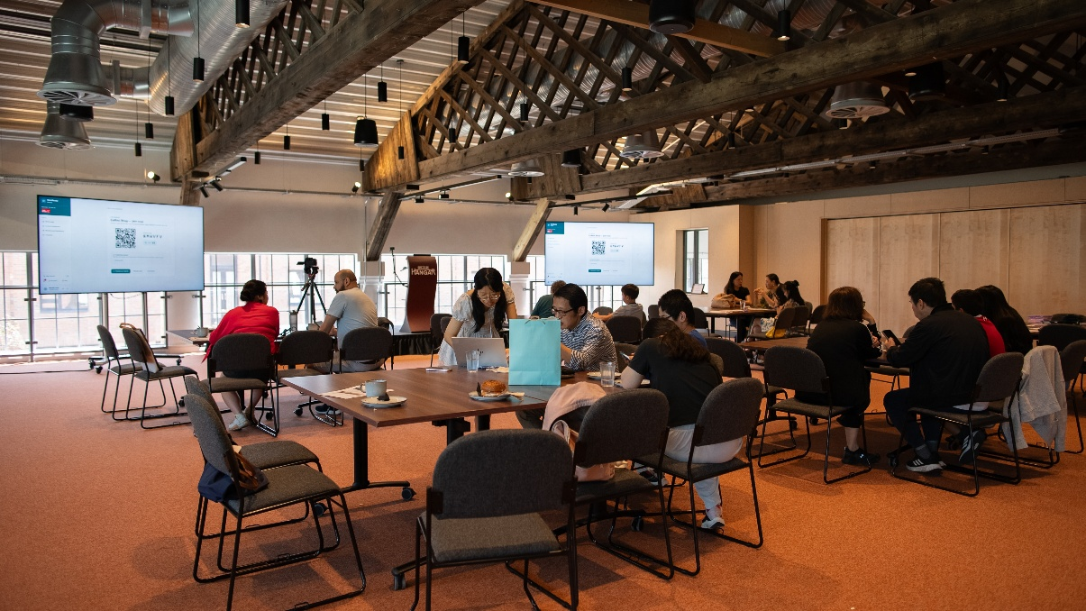
Workshop 2: Saturday 4th July 2026
13:00 - 15:00 at Spitfire Hangar, Brabazon

Slide 11
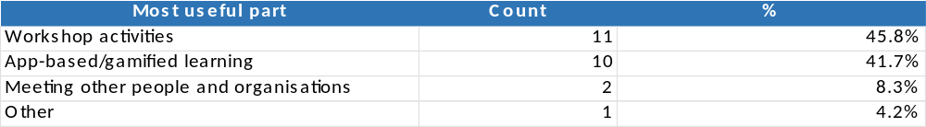
Feedback

Slide 12
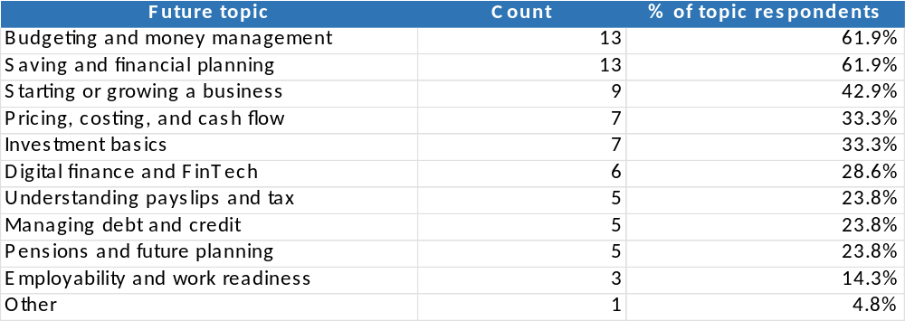
Feedback

Slide 13
WHAT THE NUMBERS SAY
Three July workshops. 26 responses.
100%
83%
96%
87.5%
SATISFIED
HELPFUL
WOULD RECOMMEND
LEARNING BY DOING
every respondent Very or Quite satisfied
found it Very or Extremely helpful
would recommend the workshop to others
named activities and the app most useful
Pilot workshops on 2, 4 and 10 July 2026. Percentages are of those who answered each question.
The room voted for learning by doing.
Notes:
Across the three July pilots on 2, 4 and 10 July, 26 people gave feedback. Every respondent who rated the workshops was satisfied, 83 percent found them very or extremely helpful, and 96 percent would recommend them. The strongest signal: 87.5 percent named the hands-on activities and the app as the most useful part. The experiential core is what lands.

Slide 14
IN THEIR WORDS
What participants took away
“
“
“
STARTING OUT
THE APP
EVERYDAY MONEY
“This will help someone wishing to start a business and give them confidence to ask questions that they are not willing to ask…”
Workshop 2, 4 July
“Excellent App, easy to use”
Workshop 2, 4 July
“It is practical and helpful for daily finance management.”
Workshop 3, 10 July
Quotes shared with written consent and kept anonymous.
Playable, practical, confidence building.
Notes:
All quotes were shared with written consent and kept anonymous. One participant said the game gives people the confidence to ask the questions they are reluctant to ask. Another called it an excellent app, easy to use. A third found it practical and helpful for daily money management. Playable, practical, confidence building.

Slide 15
WHAT HAPPENS NEXT
The feedback writes the roadmap
YOU SAID
COMING NEXT
More hands-on interaction
More practical case studies
Language and translation support
Keep the app after the workshop
Top topics: budgeting, saving, starting a business
A 3-month trading loop in the Coffee Shop
Cleaning Company and Personalised Gifts scenarios
New modules shaped by demand
Embedded in Bristol Business School teaching
More workshops in Bristol and internationally
Would they come back? No one said no.
Notes:
Participants asked for more hands-on interaction, more practical case studies, language support and continued access to the app, with budgeting and saving the most requested topics. That is exactly where the platform goes next: a deeper Coffee Shop scenario with a 3 month trading loop, the Cleaning Company and Personalised Gifts scenarios, new demand-led modules such as sustainable financial planning, embedding in Bristol Business School teaching and further community workshops. Asked about future sessions, 77 percent said yes, 23 percent said maybe, and nobody said no.

Slide 16



Our delivery partners
Redcatch Community Garden

